Slide 1
Becoming a Foss contributor

Slide 2
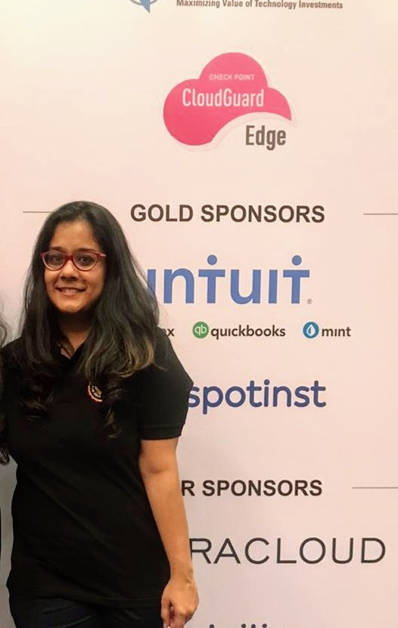
About me
Senior Systems Administrator with HSBC
AWS Community Builder
Working with CERN-HSF on Google Season of Docs, 2020
FOSS Communities I actively contribute to:
Ortelius: Marketing & Outreach team
LitmusChaos: SIG DOCS lead
Kubernetes: Release shadow on 1.19 & 1.20 releases, Storyteller on Upstream Marketing team

Slide 3
Agenda
What is FOSS?
Why is it becoming popular?
Some major challenges
What do you need to know before contributing?
How and where can you step in?
QnA

Slide 4
What is FOSS?
FOSS = Free & Open Source Software
Licensed to be free to use, modify, & distribute
First Open source software license = GNU EMACS Copying permission notice
Two types of licenses
Permissive
Copyleft

Slide 5
What is FOSS?
In FOSS projects, anyone
can access the code
can update the codebase
can dip in and out per their interest
VCS such as Github to track contributions
Generally self-organized, small internet communities

Slide 6
Why is it becoming popular?
Community-driven
Transparency
Freedom from lock-in
Lesser time to market
Lower initial costs

Slide 7
Some major challenges
Limited support
Long-term costs
Sustainability
Security
Ease of use (from an end-user perspective)

Slide 8
Before you begin...
Ensure you have bandwidth & permissions to get started
Some orgs have non-compete agreements
Ascertain interest area/s
Narrow down project/s
Reach out to community members via IRC/Slack

Slide 9
How & where to get started?
Navigate to the project’s website
Contribution guide
Documentation
Link to their Github/VCS
Tech twitter
Project Slack/IRC/Gitter/Discord
Project community calendar
Google groups
Hacktoberfest!

Slide 10
Any questions?

Slide 11
See you around!
Twitter: @Divya_Mohan02
LinkedIn: https://www.linkedin.com/in/divya-mohan0209
Github: https://www.github.com/divya-mohan0209

